Slide 1

Automated Points-to Specifications Generation
for Library APIs
Presenter : Shuangxiang Kan
Supervisor: Yulei Sui​​
1
Notes:
Hello, everyone, my name is Shuangxiang Kan.​
I am a PhD student supervised by professor Yulei Sui. ​
The topic of my Progress review is about Automated Points-to Specifications Generation for Library APIs

Slide 2
Checklist
✅
Literature review (05/09/2023)
✅
System Design (05/11/2023)
Title: Spectre: Automated Points-to Specifications Generation for Library APIs
Authors: Shuangxiang Kan, Yuekang Li, Yulei Sui
Submitted to International Conference on Software Engineering (ICSE, CORE-A*)
✅
Implementation (05/12/2023)
✅
Paper Writing (05/02/2024)
✅
Submission (05/04/2024)
Title: Cross-Language Taint Analysis: Generating Caller-Sensitive Native Code Specification for Java
Authors: Shuangxiang Kan, Yuhao Gao; Zexin Zhong, Yulei Sui
Accepted by Transactions on Software Engineering（TSE, CORE-A* ）
2
Notes:
This was the future plan I made during my last progress review. I have completed all of them, including literature review, system design, and my work ‘Spectre: Automated Points-to Specifications Generation for Library APIs’ has been submitted to ICSE 2025. And my previous work ‘Cross-Language Taint Analysis: Generating Caller-Sensitive Native Code Specification for Java‘ has been accepted by Transactions on Software Engineering.

Slide 3


Contents
1
﻿Literature Review
2
﻿Our Work
3
﻿Future Work
3
Notes:
Today’s presentation is composed of three parts.​
The first one is the literature review.​
The second part is the work I have done about the cross-language static analysis .
The last one part is future work.
Now let’s move to the literature review part.

Slide 4
Literature Review
4

Slide 5
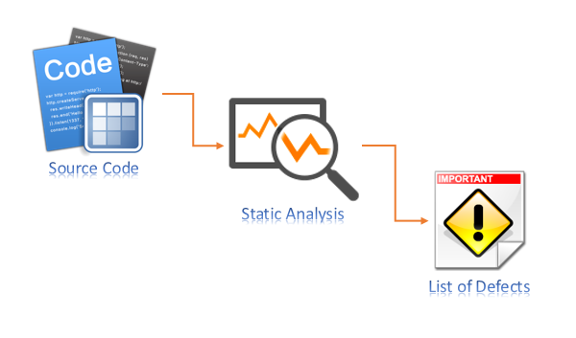




Literature review
﻿Static analysis is a technique that examines source code without
executing the program to detect potential vulnerabilities.
However, the frequent use of library APIs in programs presents
the following challenges for static analysis：
Lack of source code;
Call different programming languages ;
Call other library’s APIs ;
Complex features.
// C client code
#include “libraryA ”
int main()
{
libraryA_api_a(a); // Closed-source API
…
libraryA_api_b(b); // Implemented in Python
…
libraryA_api_c(c); // Call other library’s APIs
…
libraryA_api_d(d); // Implicit data-flow
…
}
int api_c(c) {
libraryB_api();
libraryC_api();
}
int api_d(char d) {
int vals[] = {0,1,2,3,4,5,6,7,8,9};
int idx = (int)d - ‘0’;
return vals[idx];
}
5
Notes:
﻿Static analysis is a technique that examines source code without executing the program to detect potential vulnerabilities. However, the frequent use of library APIs in programs presents some challenges for static analysis,
For example, this client code calls four library APIs，the first one is a closed-source API; without access to its source code, static analyzer has no idea what's this API for.
The second API is implemented in Python, and currently, most static analyzers are single-language; Using a single-language static analyzer to analyze cross-language code is very challenging.
In the third library API, it continues to call other different libraries APIs, and this nested API calls makes it difficult to get all source code for the APIs.
The fourth API contains implicit data-flow, which is more challenging for static analysis to handle, whereas in some cases, it is easier for dynamic analysis to hand this because it allows for observation of the code's execution.

Slide 6



Literature review
Given the stable and infrequently changing nature of library APIs, repeatedly analyzing the source code of
library APIs consumes resources without yielding new insights.
A typical workaround is to use specifications which summarize the key behaviors of the library APIs thus
avoiding repeat analysis of the source code.
Static Pointer Analysis
// Specification of strncat()
char *strncat(char *d, char *s, size_t n) {
return d;
}
// C client code
#include <string.h>
int main()
{
char dest[50] = "Hello";
const char *src = "World";
// C standard library API
strncat(dest, src, 6);
…
}
$$√$$
// Source code of strncat()
char *strncat(char *d, char *s, size_t n) {
char *a = d;
d += strlen(d);
while (n && *s) n--, *d++ = *s++;
*d++ = 0;
return a;
}
strncat(dest, src, 6);
$$×$$
Client code
Sound result
The first parameter and return value points to the same object
6
Notes:
Given the stable and infrequently changing nature of library APIs, repeatedly analyzing the source code of library APIs consumes resources without yielding new insights.
A typical workaround is to use specifications which summarize the key behaviors of the library APIs thus avoiding repeat analysis of the source code.
For instance, this C client code calls a C standard library API `strncat()`. Here is the source code of this API, whose pointer behavior is that the first parameter and the return value point to the same object. If we want to do static pointer analysis. if we use a well-summarized specification, like this one, which have the same behavior as the source code of strncat. we can avoid analyzing the API's source code while ensuring that the results of the static analysis are sound.

Slide 7
Literature review
The three common methods for generating specifications are:
1. Handwritten specifications
- Pros : Flexibility in adjusting the level of details based on different specification requirements.
- Cons: Time-consuming and error-prone.
2. Static analysis
- Pros：Comprehensively reviews code by evaluating all potential execution paths.
- Cons: Effectiveness is limited in complex scenarios where code behavior heavily depends on runtime
conditions or involves complex memory or advanced mathematical operations.
3. Dynamic analysis
- Pros：Effective in handling complex runtime scenarios.
- Cons: May miss rare execution paths and corner cases due to observing only executed paths.
7
Notes:
Currently, three common methods are used for generating specifications:

Slide 8
Literature review
Conference | Title | Authors
ICSE’22 | ﻿﻿Fuzzing Class Specifications Dynamic analysis limitation: Require manual efforts | ﻿Facundo Molina et al.
ICSE’20 | ﻿﻿Extracting Taint Specifications for JavaScript Libraries Dynamic analysis limitation: Soundness | ﻿﻿Cristian-Alexandru Staicu et al.
ECOOP’19 | ﻿Eventually sound points-to analysis with specifications. ﻿Dynamic analysis limitation: ﻿Scalability | Osbert Bastani et al.
PLDI’18 | ﻿﻿Active Learning of Points-To Specifications Dynamic analysis limitation: Precision | Osbert Bastani et al.
POPL’15 | ﻿Specification inference using context-free language reachability. Static analysis limitation: ﻿Scalability and require manual efforts | ﻿Osbert Bastani et al.
APLAS’13 | ﻿Automated inference of library specifications for source-sink property verification Static analysis limitation: Require manual efforts | ﻿Haiyan Zhu et al.
8
Notes:
Here’s the papers related to specification generation. These papers mainly employ dynamic and static analysis, but some of the work may involve a significant amount of manual effort, or have limitaions about soundness and scalability.

Slide 9
Our work
Work 1: Grey-box Fuzzing Based Points-to Specifications Generation for Library APIs
Work 2: Large Language Models-Aided Points-to Specifications Generation for Library APIs
9
Notes:
Next, we will show our two works regarding specification generation.

Slide 10

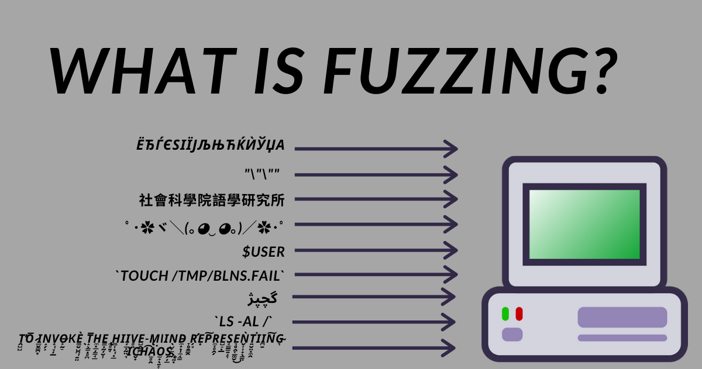
Our work
How to combine the advantages of static analysis and dynamic analysis? That is, static analysis can examine all cases, while dynamic analysis is not limited by runtime conditions.
Grey-box Fuzzing is a dynamic testing technique that involves
generating random data into a program to explore all possible
paths and find vulnerabilities and bugs.
10
Notes:
As we said before, static and dynamic analysis each have their own advantages in generating specifications, this prompts us to think about how to combine the strengths of static and dynamic analysis.
Therefore, we think about using fuzzing method to generate specifications.

Slide 11
Our work
However, using grey-box fuzzing to infer library API specifications faces two challenges:
Challenge 1
Existing grey-box fuzzing primarily detect program crashes and fall short in capturing the parameter-ret
relationships from the execution results.
To address Challenge 1, we propose a lightweight Specification check code algorithm to capture the relationships
between parameters and return value in library API.
Challenge 2
Most grey-box fuzzing techniques focus on maximizing code coverage, which does not aim to effective exploration
of the parameter-ret relationships.
To address Challenge 2, while retaining the existing coverage-guided strategy of grey-box fuzzing, We design
new instrumentation, seed selection, power scheduling, and seed mutation features tailored to explore the
relationships between library API parameters and return values.
11

Slide 12



Our work
Work 1
Address Challenge 1: Specification check code algorithm
1. cJSON *GetObjectItem(cJSON *object, char *name) {
2. cJSON *current_element = object->child;
3. while (strcmp(name, current_element->string) != 0) {
4. current_element = current_element->next;
5. }
6. return current_element;
7. }
struct cJSON {
cJSON *child;
cJSON *next;
char *string;
...
}
Specification check code algorithm
Input: The signature of library API
Output: Specification check code
int main(){
cJSON *json = “…”;
cJSON *name_item = GetObjectItem(json, “name”);
if (name_item == json->child ）{
// Specification generation code
}
if (name_item == json->child->next-> … ->next){
// Specification generation code
}
…
}
cJSON *GetObjectItem(cJSON *object, char *name) {
return object->child;
}
$$√$$
cJSON *GetObjectItem(cJSON *object, char *name) {
return object->child->next->…->next;
}
$$×$$
Specification is unsound, as it’s the child of Specification
12
Notes:
To address challenge, we propose Specification check code algorithm. We will insert the check code after the call of the library API in the test case to detect potential points-to relationships between parameters and return values.
However, this does not mean that we will check all possible points-to relationships between parameters and return values. For instance, in these two cases, the points-to relationships arise during runtime. But since the specification generated by the second check code is a child of the specification generated by the first check code, if we use the specification generated by the second check code to represent the pointer behavior of the API, it would make the final static analysis results unsound.
Therefore, before inserting check code, we will analyze the types of parameters and return values to avoid inserting check code that would generate unsound specifications.

Slide 13
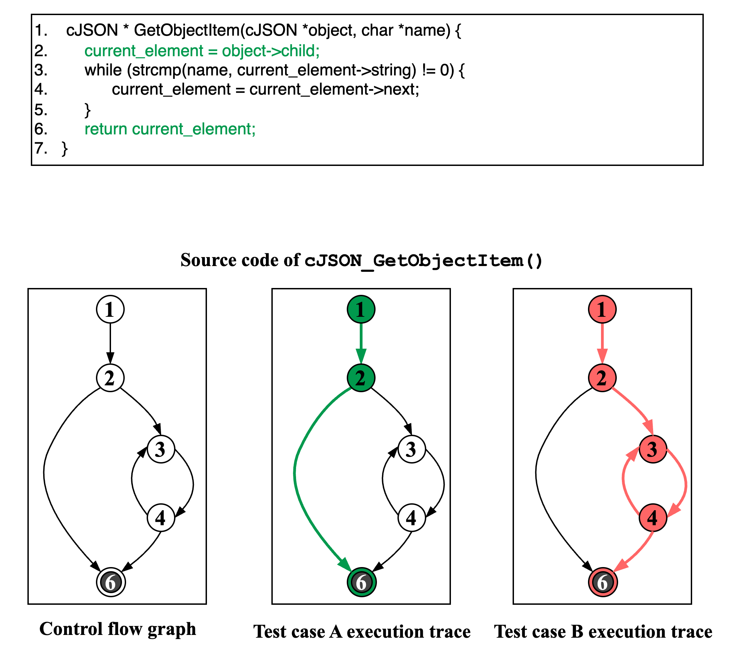
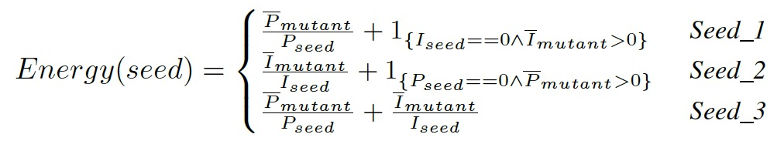


Our work
Work 1
Address Challenge 2:
New Instrumentation (Params-Ret instructions):
Basic blocks that include instructions with two or more direct or indirect parameters.
Basic blocks that include instructions where at least one parameter is used as a return value.
Seed selection:
Seed_1: Seed that only triggers new paths;
Seed_2: Seed that only triggers Params-Ret instructions;
Seed_3: Seed that both triggers new paths and Params-Ret instructions;
Power scheduling:
Seed mutation:
Copy, swap, and append parts or all of the original seed data
$$√$$
$$×$$
specification
specification
13
Notes:
To address challenge 2, we have added new features, including New Instrumentation, Seed selection, Power scheduling, and Seed mutation. These newly added features aim to let fuzzer to generate test cases that can trigger specification generation check code as quickly as possible during fuzzing.

Slide 14
Our work
Work 1
RQ1 (Comparison with Manual Efforts):
How is the quality of specifications generated by SPECTRE compared to those handwritten specifications?
Can SPECTRE generate specifications similar to the manually written ones?
RQ2 (Comparison with Source code):
How do the static analysis results of a program using specifications generated by SPECTRE compare
with those of a program that includes the source code of the library APIs?
RQ3 (Fuzzing Enhancement Impact):
How do the tailored features (new instrumentation, seed selection, power scheduling, and seed mutation)
in SPECTRE impact the specification generation?
14
Notes:
We conduct three experiments to answer the following three questions.

Slide 15
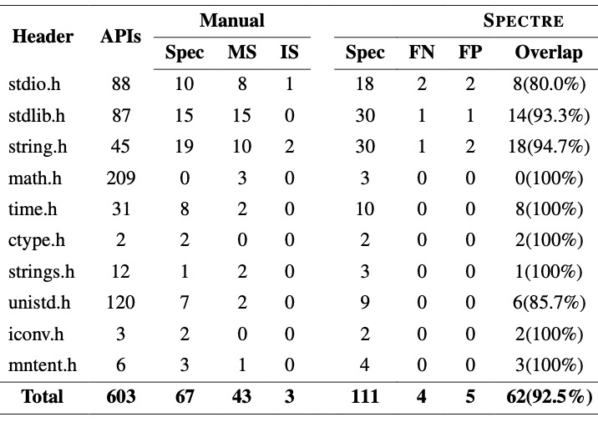
Our work
Work 1
RQ1 (Comparison with Manual Efforts):
Note that SVF has more than 6 kinds of specifications we aim to identify
Benchmark:
C standard library Musl-1.2.4
Baseline:
Specifications inferred by Spectre VS handwritten specifications in SVF
15
Notes:
The benchmark used in first experiment is C stand library Musl, as C standard library is been widely used and in a famous static analyzer SVF, their specifications are manually summarized.
Therefore, we use handwritten specifications in SVF to compare the specifications inferred by Spectre.
From the experimental results, it can be seen that Spectre achieved an accuracy of 92.5% compared to handwritten specifications.

Slide 16
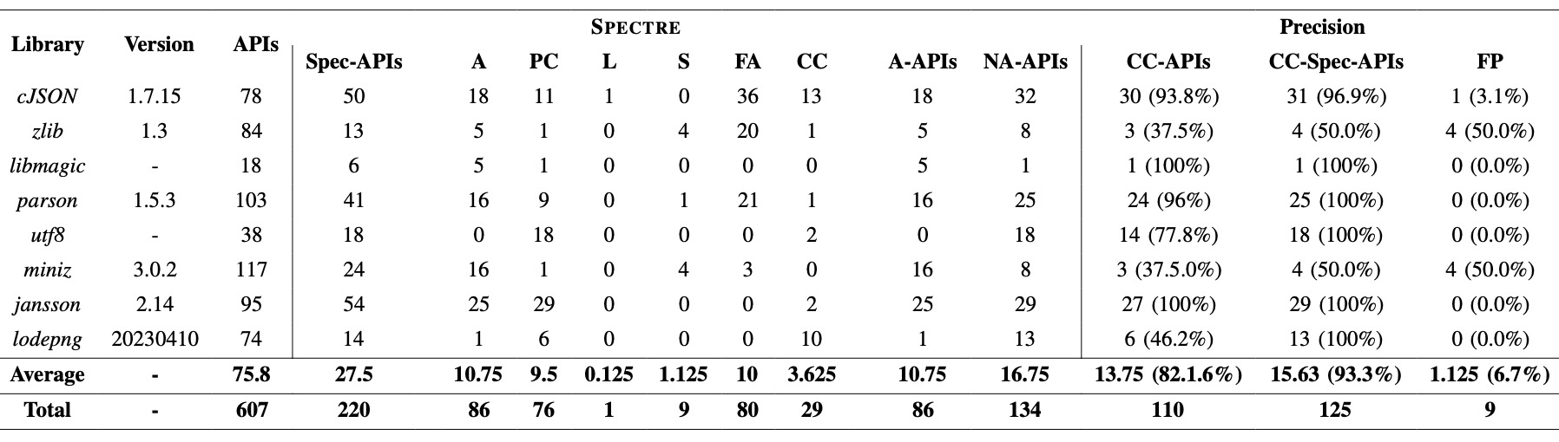
Our work
Work 1
RQ2 (Comparison with Source code):
Benchmark:
Eight third-party C/C++ libraries
Baseline:
Static analysis results of client code with specifications VS source code of library APIs
16
Notes:
In the second experiment, we use 8 third-party C/C++ libraries as benchmark.
From the experimental results, it can be seen that Spectre achieved an accuracy of 93.3% compared to handwritten specifications.

Slide 17
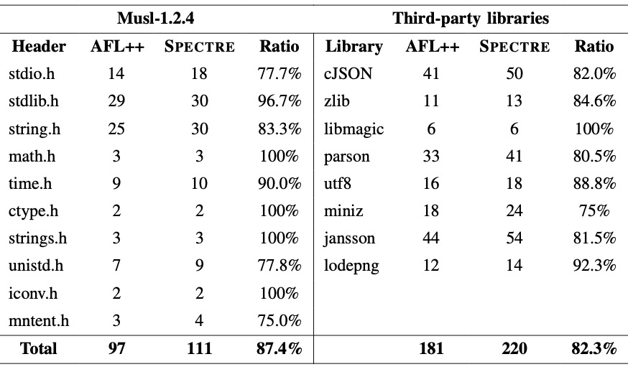
Our work
Work 1
RQ3 (Fuzzing Enhancement Impact):
Benchmark:
The original AFL++;
Baseline:
Specifications generated by AFL++ VS Specifications generated by Spectre
17
Notes:
In the third experiment, we want to know if the added features can improve the performance of original grey-boxing fuzzing techniques.
Since Spectre is built on the grey-box fuzzing tool AFL++, we will compare the ability of AFL++ and Spectre to generate specifications.
For both the C standard library and 8 third-party libraries, Spectre discovered more specifications compared to the original AFL++.
From the experimental results, it can be seen that compared to Spectre, AFL++ only generated 87.4% of the specifications in musl-1.2.4, and in 8 third-party libraries, AFL++ only generated 82.3% of the specifications.

Slide 18

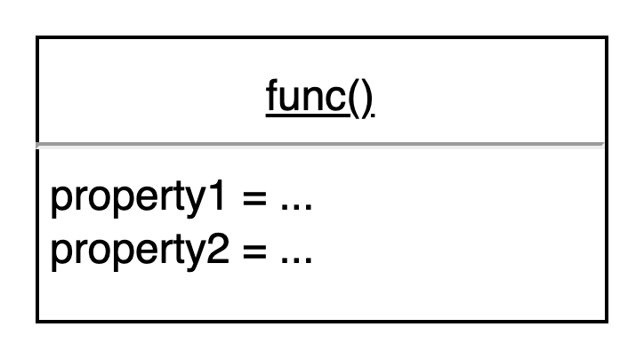
Our work
Work 2
Generative Large Language Models (LLMs) have gained significant attention for their capabilities in code-related tasks,
such as code completion, code synthesis, and program repair. Therefore, we are exploring the potential of leveraging
LLMs‘ code understanding abilities to assist us in extracting the points-to specifications about library APIs.
LLM
18
Notes:
Next, we will talk about our second work. Currently, Large Language Models (LLMs) have gained significant attention for their capabilities in code-related tasks,
such as code completion, code synthesis, and program repair. Therefore, we are exploring the potential of leveraging
LLMs‘ code understanding abilities to assist us in extracting the points-to specifications about library APIs.

Slide 19

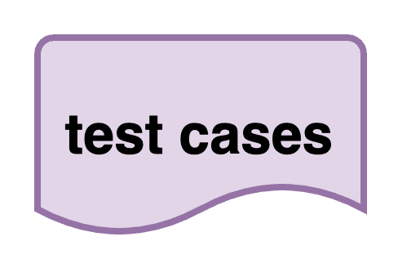


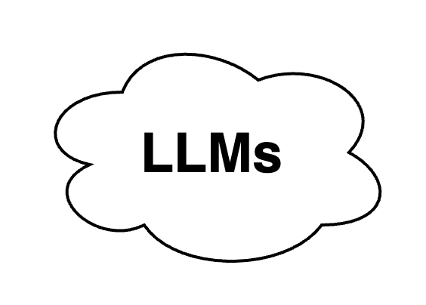
Our work
Work 2
…
…
…
…
Prompt
+
Prompt
+
preprocess
pass
Source code
Workflow
19
Notes:
Here is the workflow of our approach. First, we preprocess the source code by breaking it down into \ individual functions. Next, we use prompt engineering to have the LLM produce points-to specifications for each API. To verify the correctness of the generated specifications, we need to validate them using test cases. We also use LLMs to generate test cases, and we employ an algorithm ensure the correctness of the specifications. If the specifications pass the validation, we consider the generated specifications are correct.

Slide 20
Our work
Work 2
Bottom-Up Function Specification Extraction
void *A(){
…
}
void *B(){
A();
…
}
void *C(){
B();
…
}
Spec_A()
void *B(){
Spec_A();
…
}
void *C(){
Spec_B();
…
}
Since APIs may involve calls to other APIs, inputting all
source code into LLMs could exceed token limits and overwhelm
their memory capacity. Thus, we adopt a bottom-up approach for
specification extraction:
First, we extract specifications for APIs without calls or
those calling standard library APIss.
2. Next, we extract specifications for APIs calling the
previously summarized ones.
Spec_B()
Spec_C()
20
Notes:
For example, if API C calls API B, and API B calls API A, we will first generate the specification for A. Then, using Specification A and the source code of B, we produce the specification for B. Finally, we use Specification B and the source code of C to generate the specification for C.

Slide 21


Our work
Work 2
﻿Test cases are also generated using LLMs. We adopt an approach similar to the RANSAC algorithm to validate the generated specifications. Our approach is based on the following assumptions:
The code solutions and the test cases are independently
and randomly sampled from the large language
model;
(2) Incorrect specification solutions are often diverse, and the
probability of having a functionality agreement between
two incorrect specifications solutions by chance is very low.
Test_case1
Spec_solution1
Test_case2
Spec_solution2
Test_case3
Spec_solution3
Test_case4
Test_case4
pass
$$√$$
{Spec_solution1, Spec_solution3}
{Test_case1, Test_case2, Test_case3, Test_case4}
{Spec_solution2}
pass
$$×$$
{Test_case2, Test_case3, Test_case4}
21
Notes:
Because we continue using LLMs to generate test cases to validate specifications. To ensure the correctness of Specifications and testcase, we adopt an approach similar to the RANSAC algorithm. We use LLM to generate a set of specification solutions for API and a set of test cases. Then we use each test case to validate each specification. For example, Spec_solution1 and Spec_solution3 pass for test cases, and Spec_solution2 only pass 3 test cases, Therefore, we think the specifications from the Spec_solution1, Spec_solution3 are correct.

Slide 22
Our work
Work 2
Header | APIs | Manual | LLM | Spec-Attempt | Test-Attempt
stdio.h | 88 | 10 | 19 | 1.2 | 1.9
stdlib.h | 87 | 15 | 31 | 1.4 | 1.7
string.h | 45 | 19 | 30 | 1.1 | 1.5
math.h | 209 | 0 | 3 | 1.1 | 2.1
time.h | 31 | 8 | 10 | 1.2 | 1.8
ctype.h | 2 | 2 | 2 | 1.3 | 2.3
strings.h | 12 | 1 | 3 | 1.1 | 1.2
unistd.h | 120 | 7 | 10 | 1.2 | 1.4
iconv.h | 3 | 2 | 2 | 1.1 | 1.6
mntent.h | 6 | 3 | 4 | 1.4 | 1.7
Average | 60.3 | 6.7 | 11.1 | 1.2 | 1.7
More experiments are coming soon ...
We plan to submit work 2 to International Conference on Automated Software Engineering (ASE, CORE-A*).
22
Notes:
We have conducted experiments on 10 commonly used libraries in the C standard library and compared the experimental results with previously hand-written specifications. The experimental results show that using the LLM approach allowed us to find more specifications than manual efforts. Moreover, for both specification generation and test case generation, we were able to get correct results within two attempts in most cases. This shows the effectiveness of our approach.

Slide 23
Future work
23

Slide 24
Future work
After completing work 2, we will further leverage large language models and explore applying the function
summarization and approaches from our previous work to enable analysis and verification
across multiple programming languages.
Literature review
(09/06/2024)
System Design
(01/07/2024)
Implementation
(01/09/2024)
Paper Writing
(01/11/2024)
Submission
(01/12/2024)
Experiments (15/05/2024)
Paper Writing and submission (08/06/2024)
Timeline:
24
Notes:
We will complete all the experiments and submit the paper before June 8th. Then, we will continue to explore the application of LLMs in analysis and verification across multiple programming languages. We will first conduct a literature review, followed by system design with our supervisor. After that, we will implement our ideas and complete the writing and submission of our paper.

Slide 25

Thank you
And Questions ?
25

